Slide 1
Liferay 6.1: More Sophisticated Website Management
Juan Fernández
Liferay Core Engineer

Slide 2

Embracing complexity

Slide 3
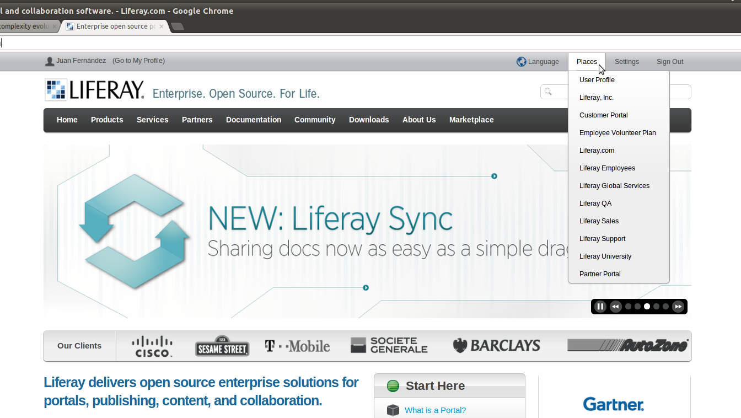
Just an (small) example...

Slide 4
What are the challenges?
- Focus on non-tech savvy websites administrators
- Easy creation and management of hundreds of sites
- Advanced content management

Slide 5
What's our response?
- Page templates
- Site templates
- Staging
- Pages and sites variations

Slide 6
Exploring Multi Sites
- Many totally different sites with some common pages
    → Page templates
- Many similar sites with some differences
    → Site Templates

Slide 7
Page templates

Slide 8
Site templates

Slide 9



Staging (local & remote)
Site Users
Site Admins

Slide 10

Page Variations
Your website
Home
About Us
Contact Us
Home (normal)
Home (special)

Slide 11
Site Variations
Your website
Normal Version
Christmas Version
Valentine's Day Version

Slide 12
And many more!
- Advanced hierarchical permission system
- Improved site membership management interface
- Comprehensive API

Slide 13

Thanks!
Questions?
@
juan.fernandez@liferay.com
@juanferrub

